Slide 1






Slide 2
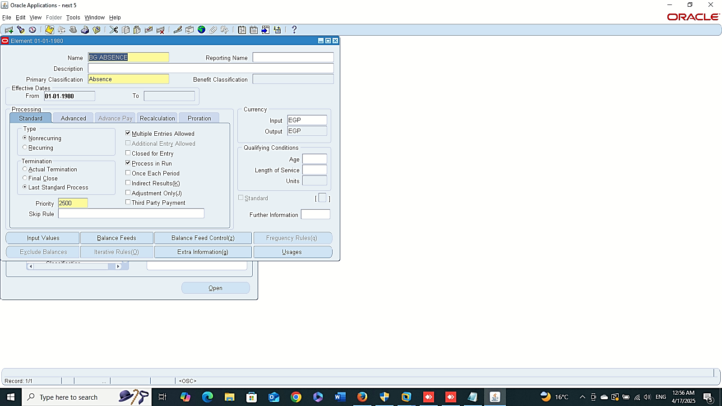
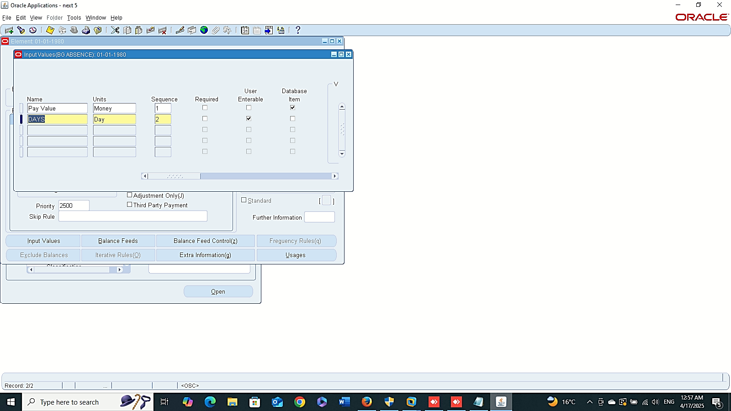
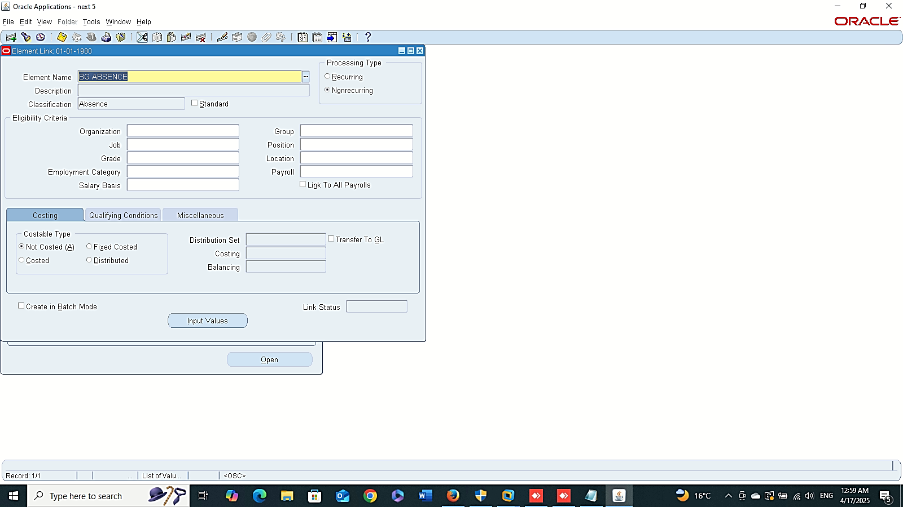
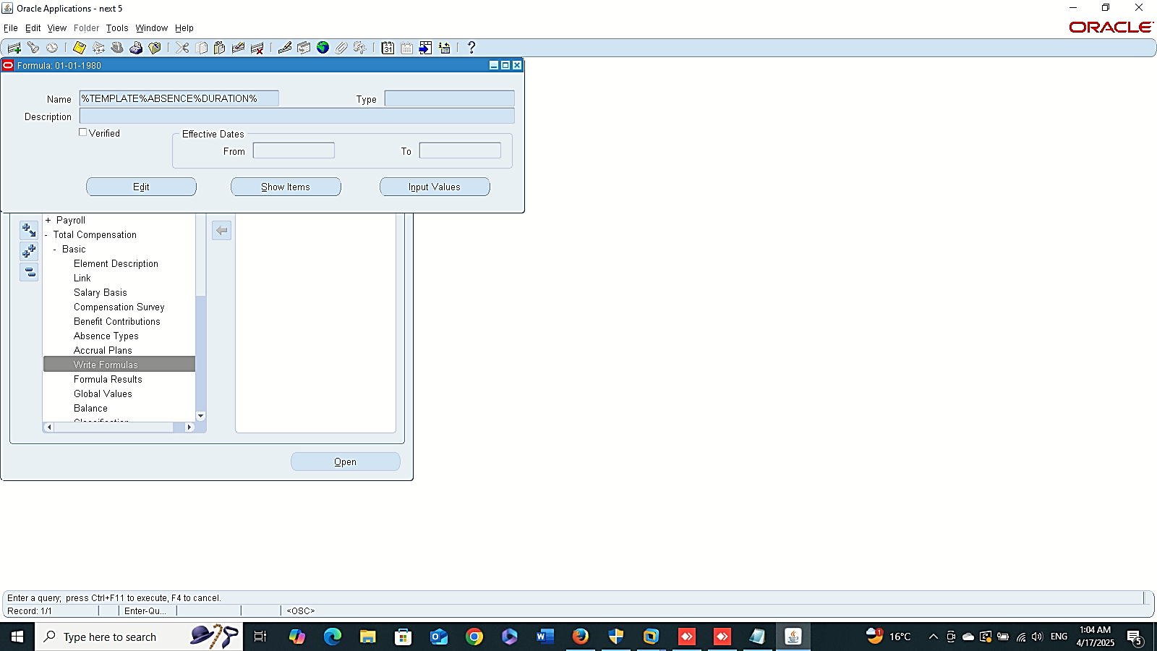
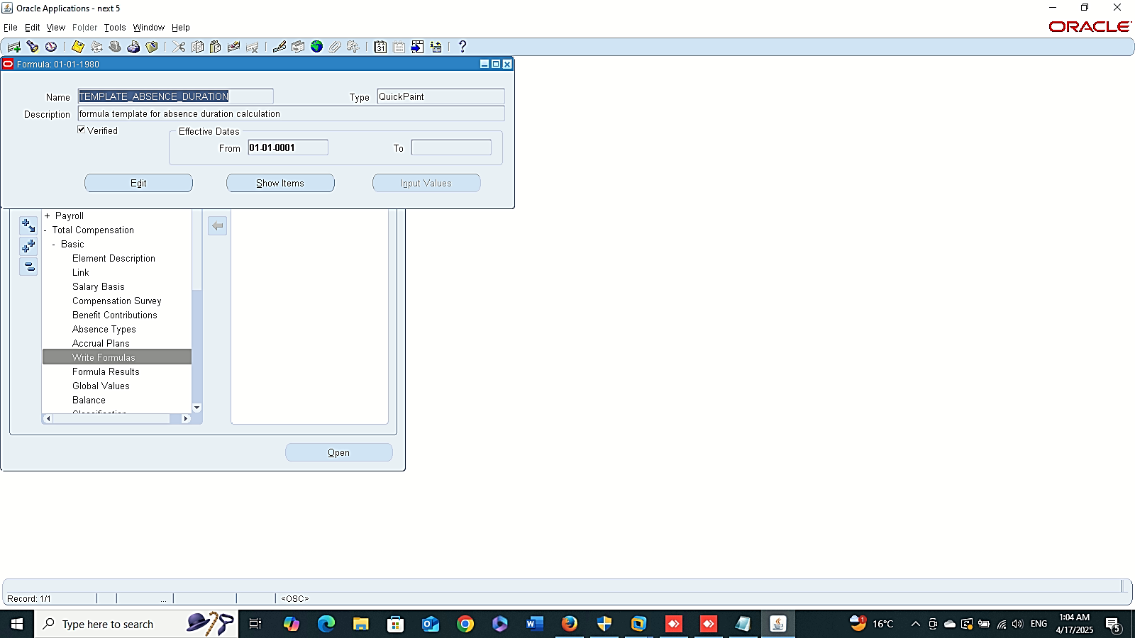
Create Element
Create Element
Finance Management (Payroll)
Absence Management :
“Setup BG Absence”
1- Create a New Element
GLOBAL HRMS MANAGER > TOTAL COMPENSATION > BASIC > ELEMENT
2- Element Link
GLOBAL HRMS MANAGER > TOTAL COMPENSATION > BASIC > LINK
3- Create a New Formula
GLOBAL HRMS MANAGER > TOTAL COMPENSATION > BASIC >WRITE FORMULA
Element Link
Create Formula

Slide 3
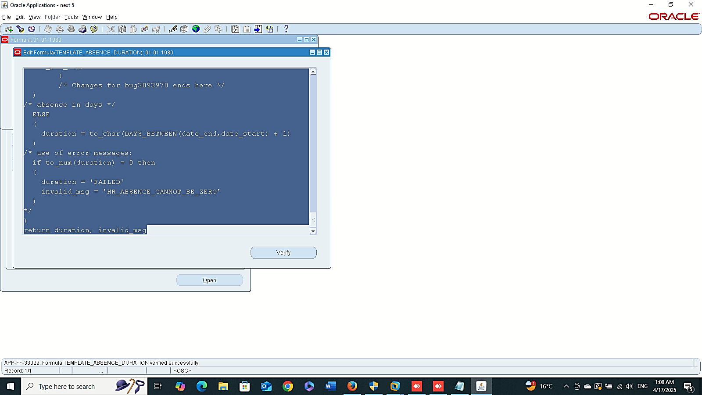
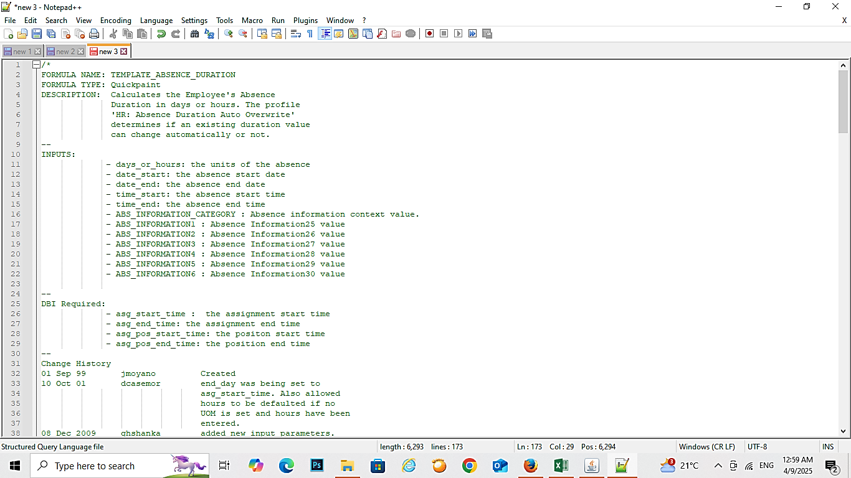
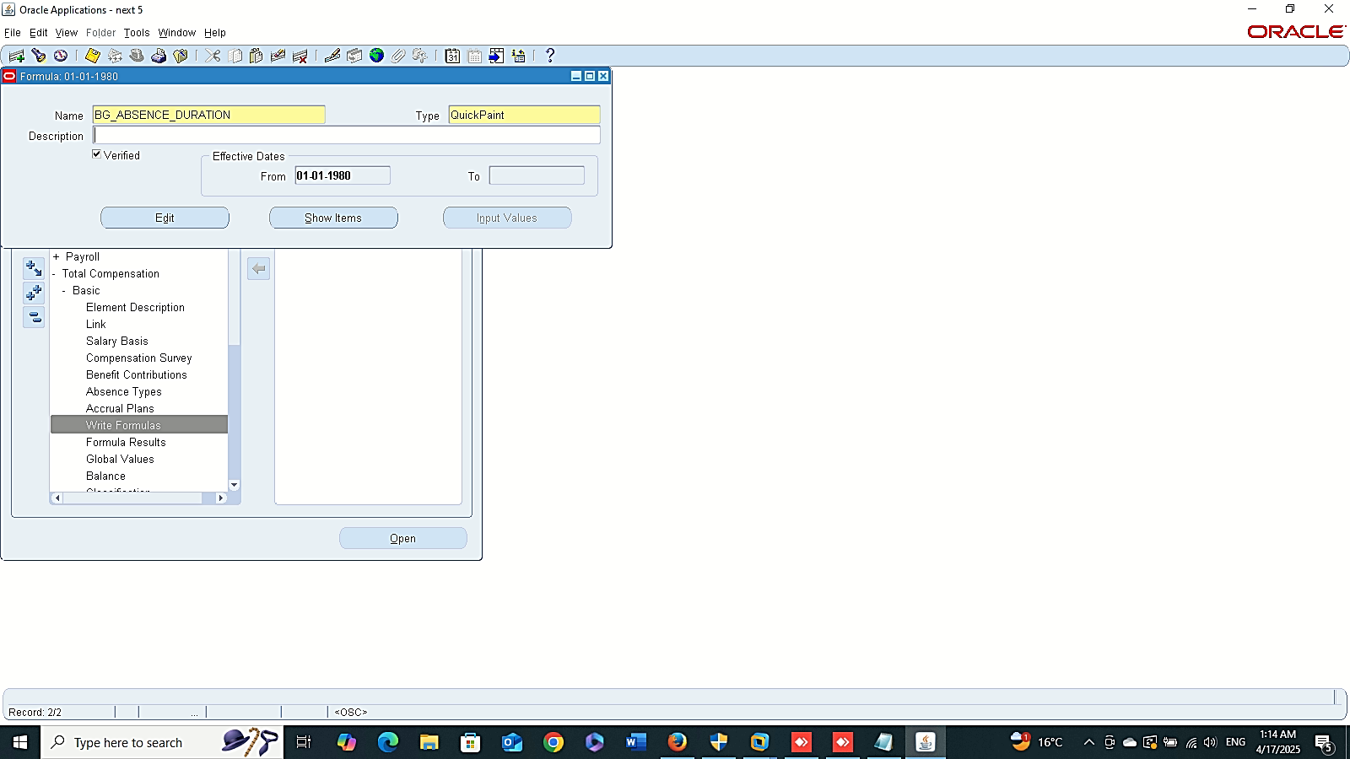
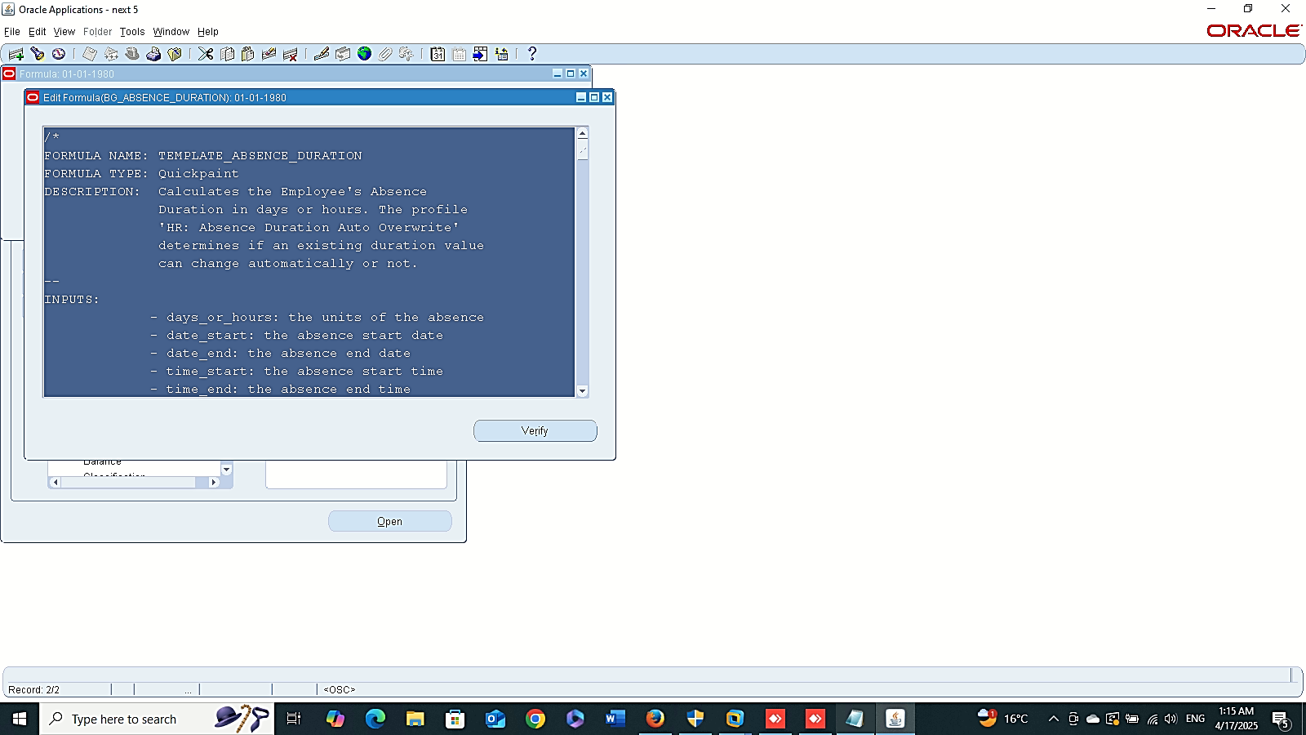
Edit
Finance Management (Payroll)
Absence Management :
“Setup BG Absence”
--- Edit
GLOBAL HRMS MANAGER > TOTAL COMPENSATION > BASIC > ELEMENT
--- New
GLOBAL HRMS MANAGER > TOTAL COMPENSATION > BASIC > LINK
New

Slide 4
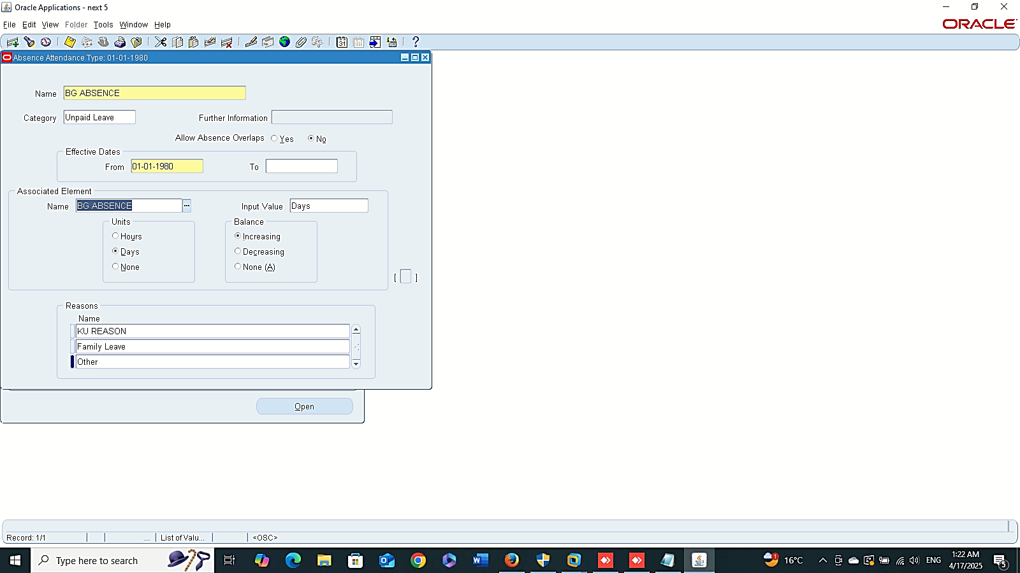
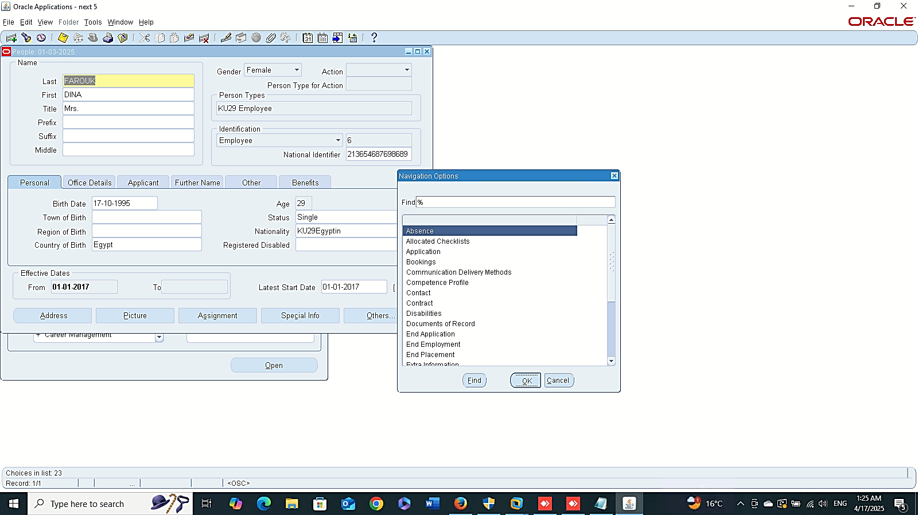
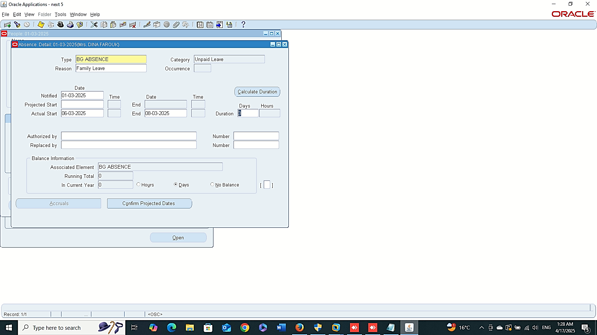
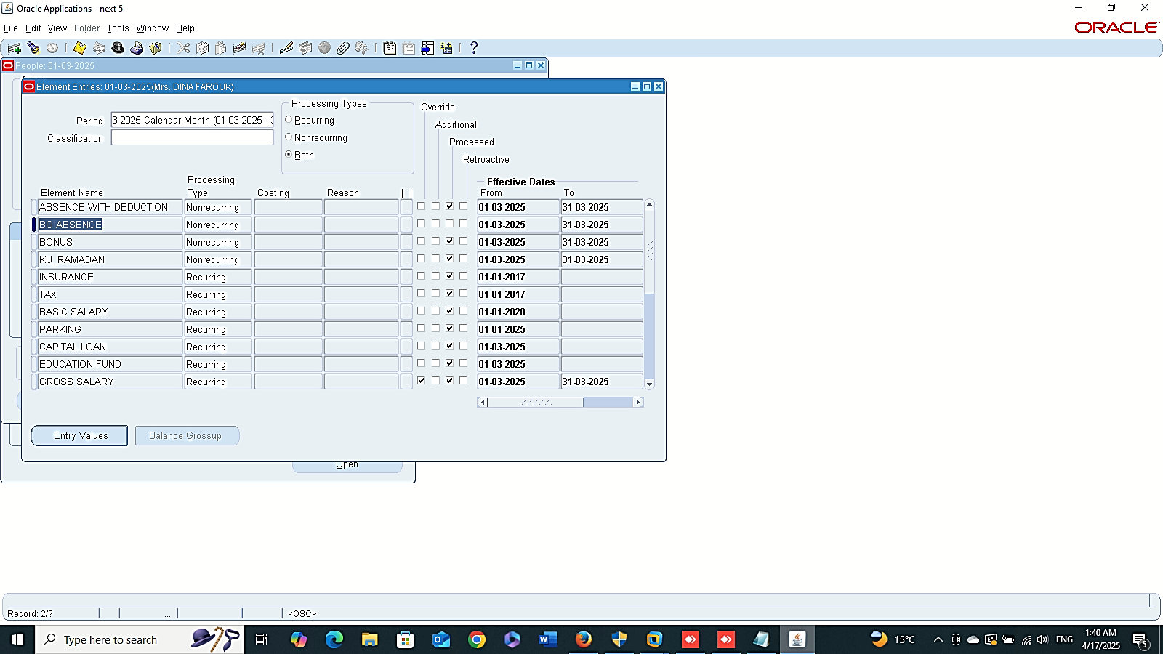
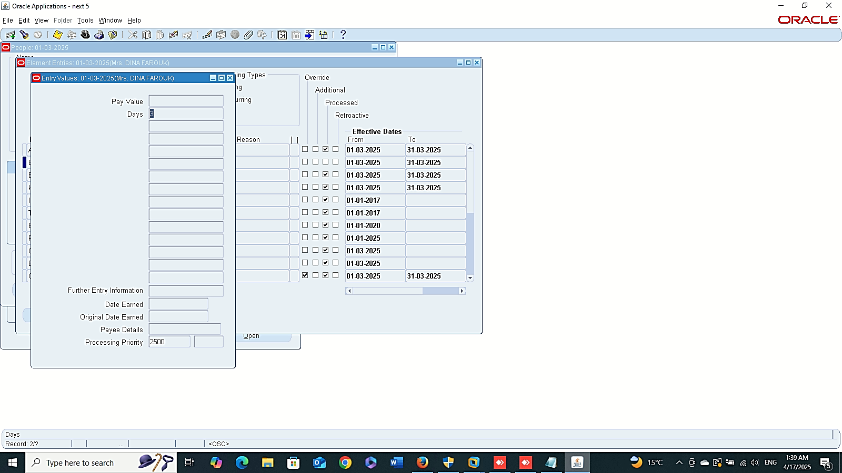
Absence Type
Absence Details
Finance Management (Payroll)
Absence Management :
“Setup BG Absence”
4 - Absence Type
GLOBAL HRMS MANAGER > TOTAL COMPENSATION > BASIC > ABSENCE TYPE
5 - Absence Details
GLOBAL HRMS MANAGER > PEOPLE > ENTER AND MAINTAIN > FIND > OTHER > ABSENCE
Entries

Slide 5
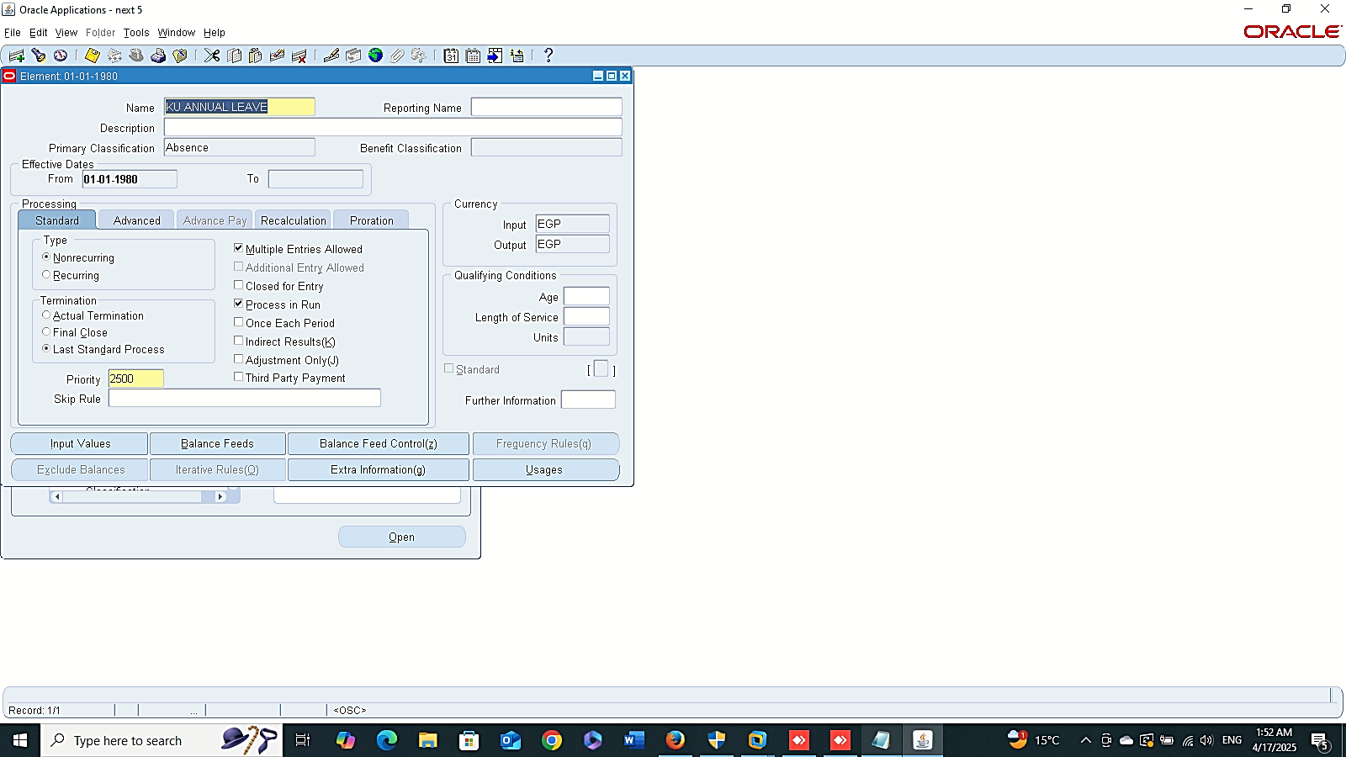
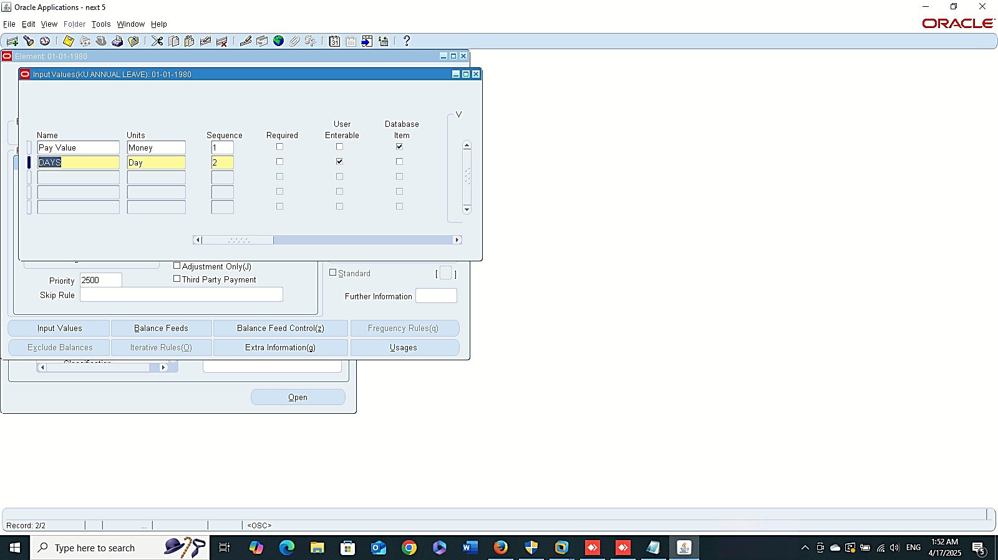
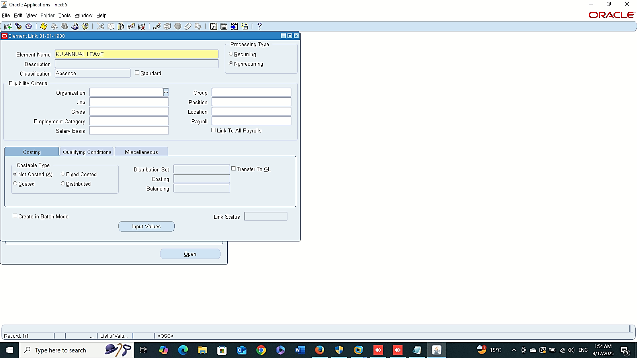

Create Element
Finance Management (Payroll)
Absence Management :
“Accrual Plans Setup”
1- Create New Element
GLOBAL HRMS MANAGER > TOTAL COMPENSATION > BASIC > ELEMENT
2- Element Link
GLOBAL HRMS MANAGER > TOTAL COMPENSATION > BASIC > LINK
3- Absence Type
GLOBAL HRMS MANAGER > TOTAL COMPENSATION > BASIC > ABSENCE TYPE
Element Link
Absence Type

Slide 6
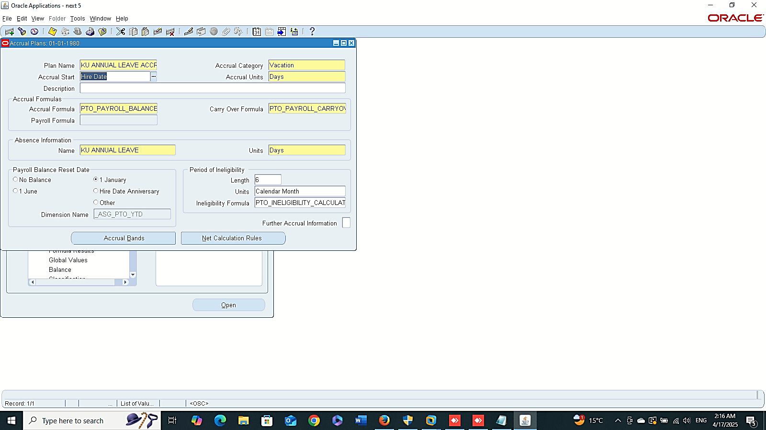
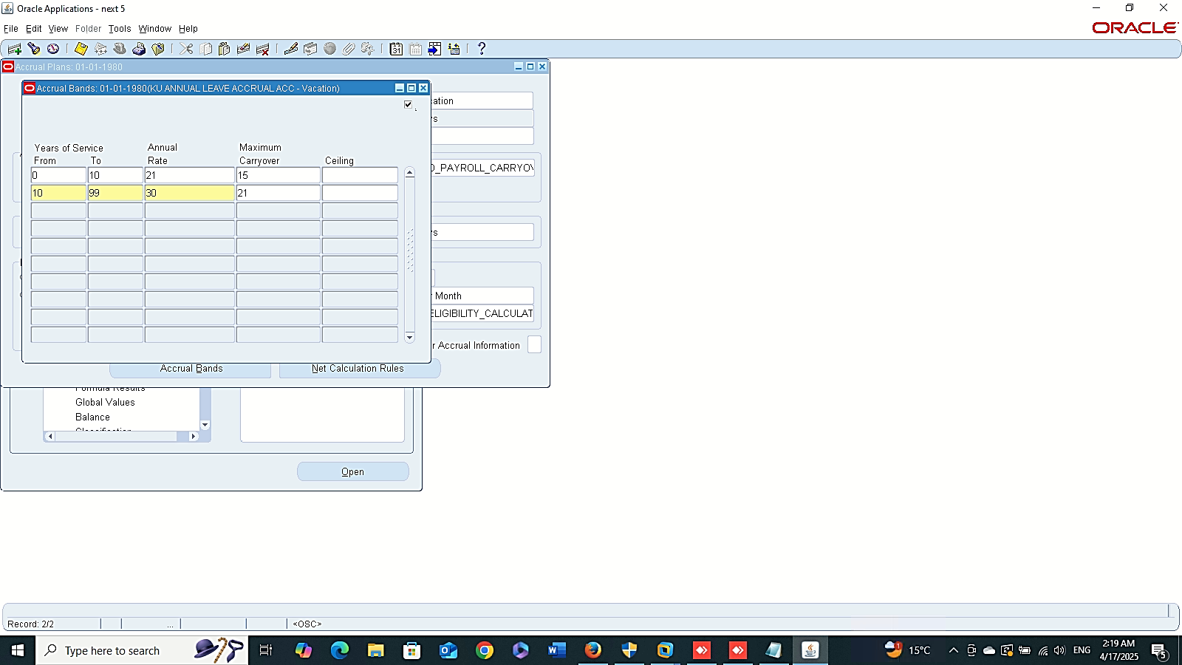
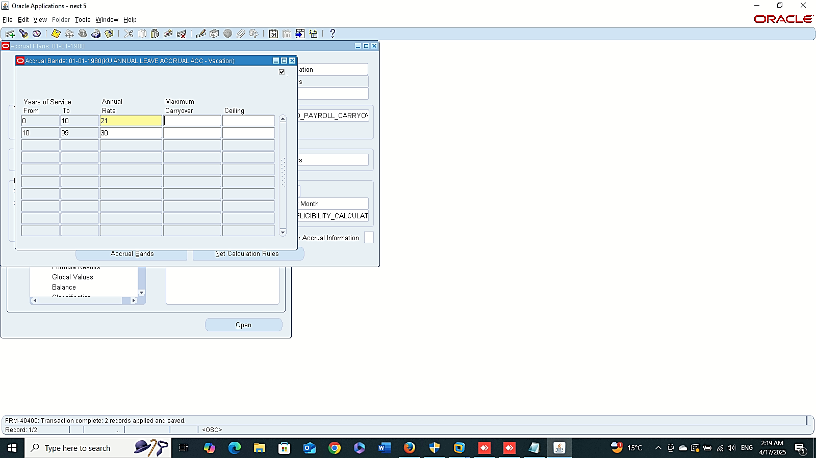
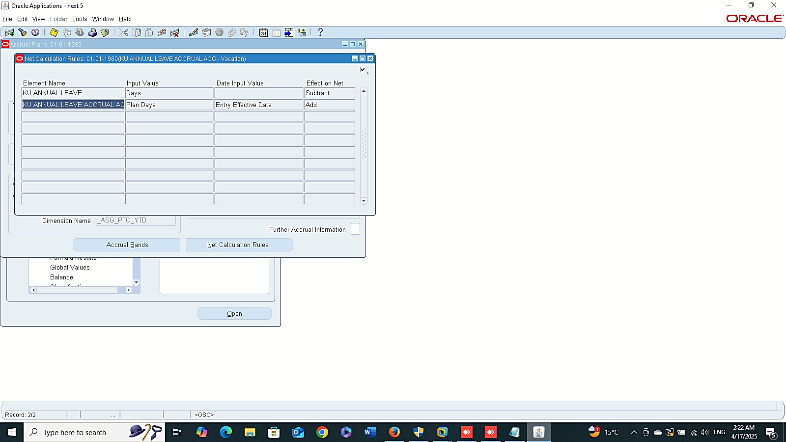
Accrual Bands
Finance Management (Payroll)
Absence Management :
“Accrual Plans Setup”
4- Accrual Plans
GLOBAL HRMS MANAGER > TOTAL COMPENSATION > BASIC > ACCRUAL PLANS
ACCRUAL PLAN NAME:
KU ANNUAL LEAVE ACCRUAL ACC
ACCRUAL FORMULA:
PTO_PAYROLL_BALANCE_CALCULATION
CARRY OVER FORMULA:
PTO_PAYROLL_CARRYOVER
ELEMENT NAME:
KU ANNUAL LEAVE

Slide 7
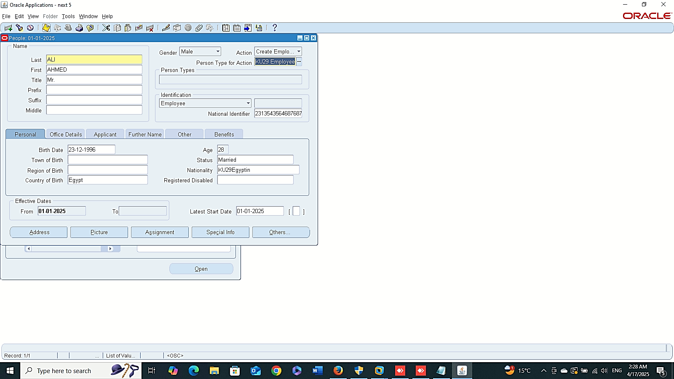
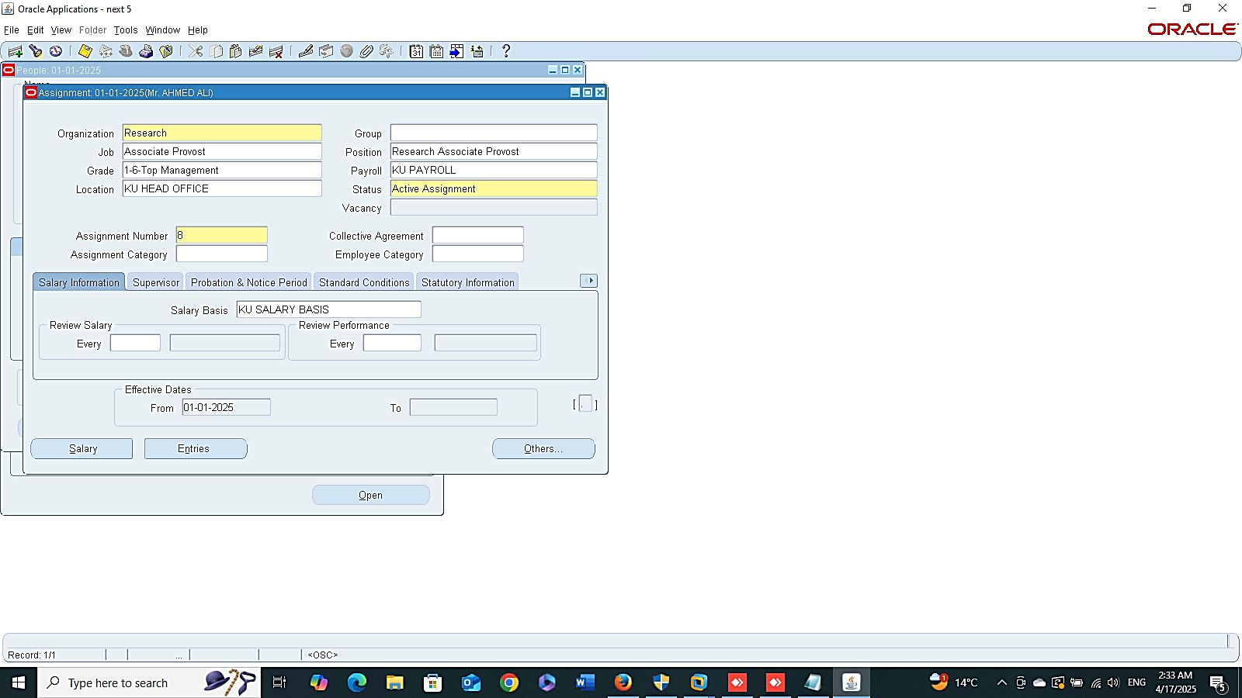
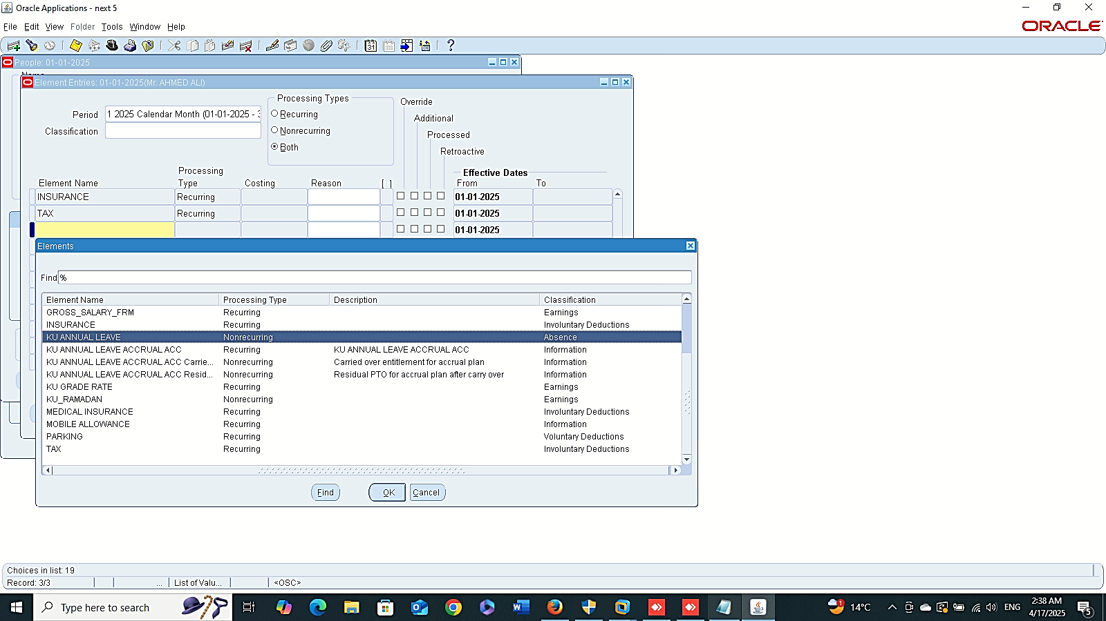
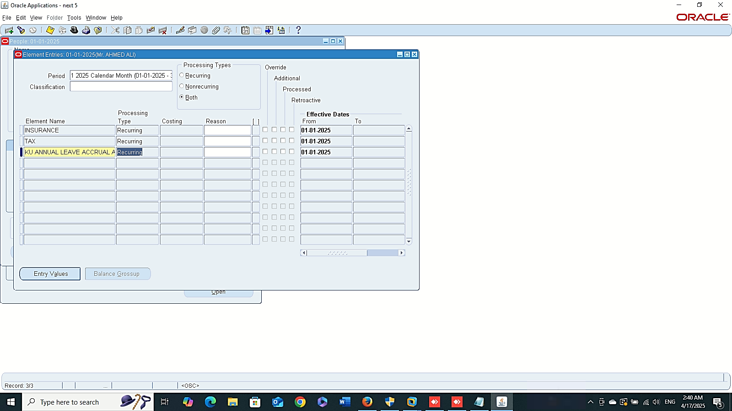
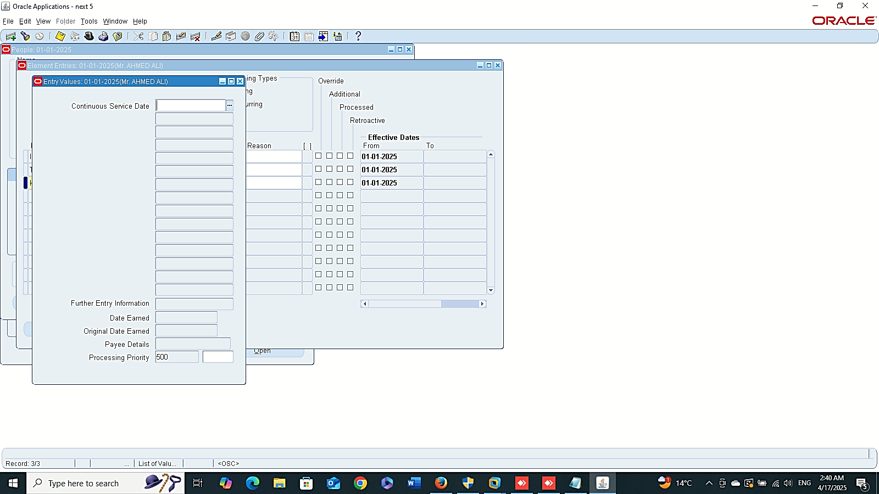
Finance Management (Payroll)
Absence Management :
“Accrual Plans Setup”
- Create New People
GLOBAL HRMS MANAGER > PEOPLE > ENTER AND MAINTAIN > NEW
Entries

Slide 8

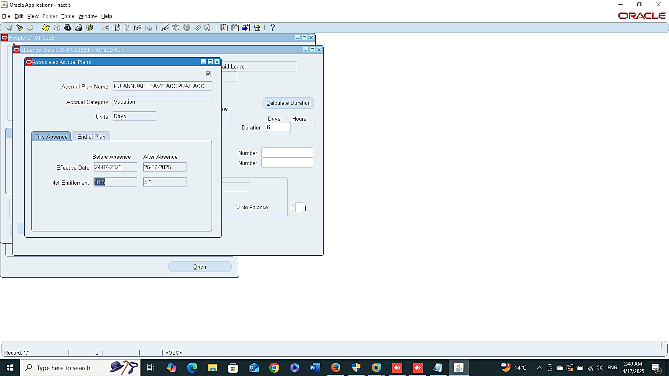

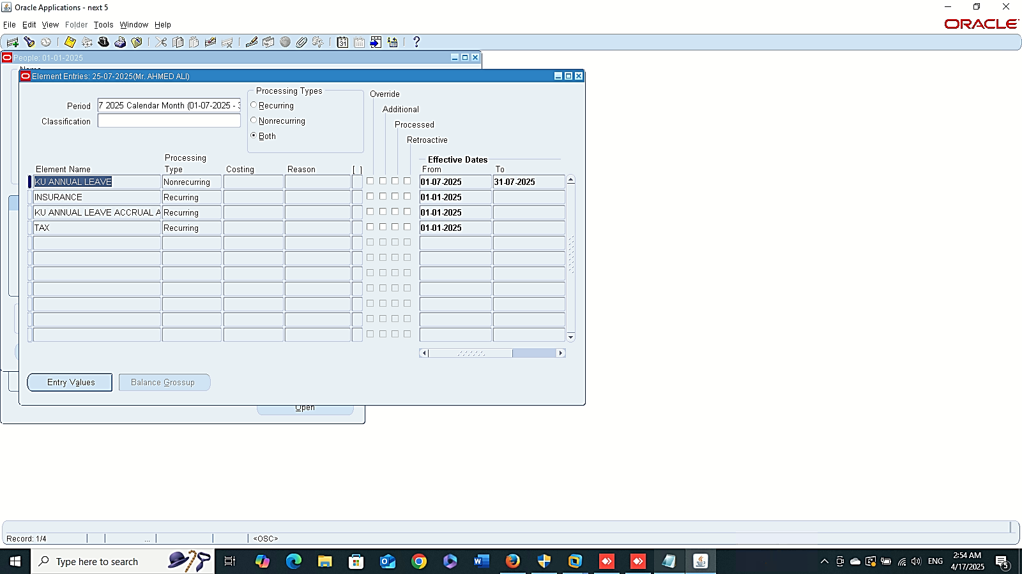
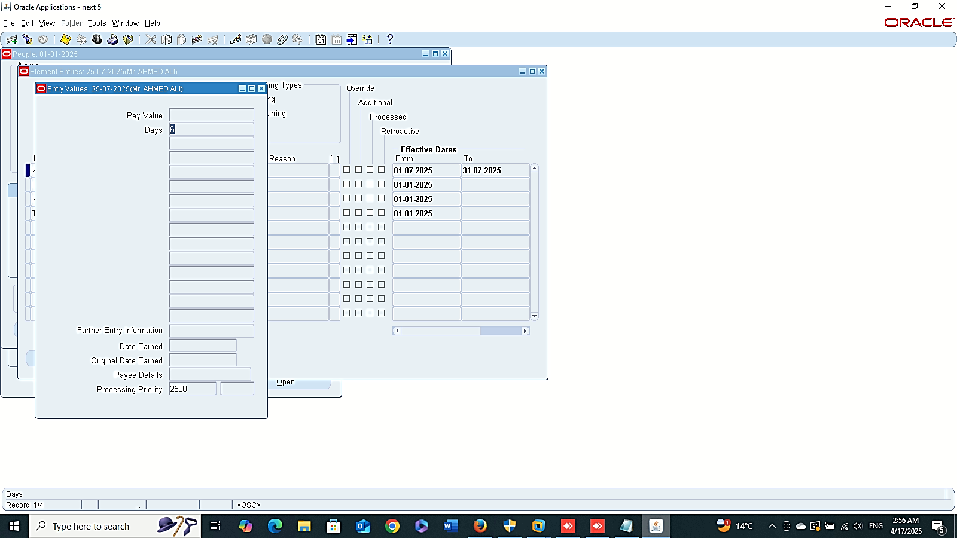
Absence Details
Accruals
Finance Management (Payroll)
Absence Management :
“Accrual Plans Setup”
- Absence Details
GLOBAL HRMS MANAGER > PEOPLE > ENTER AND MAINTAIN > FIND > OTHER > ABSENCE
- Accruals
- Entries (Annual Leaves)
Annual Leaves

Slide 9
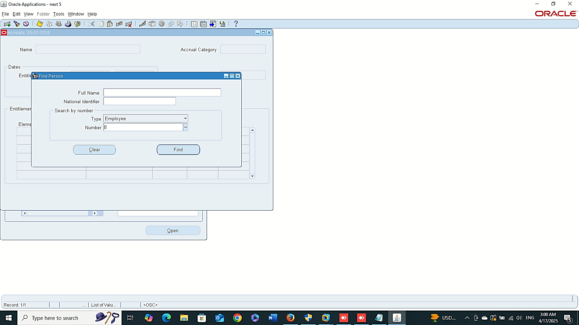
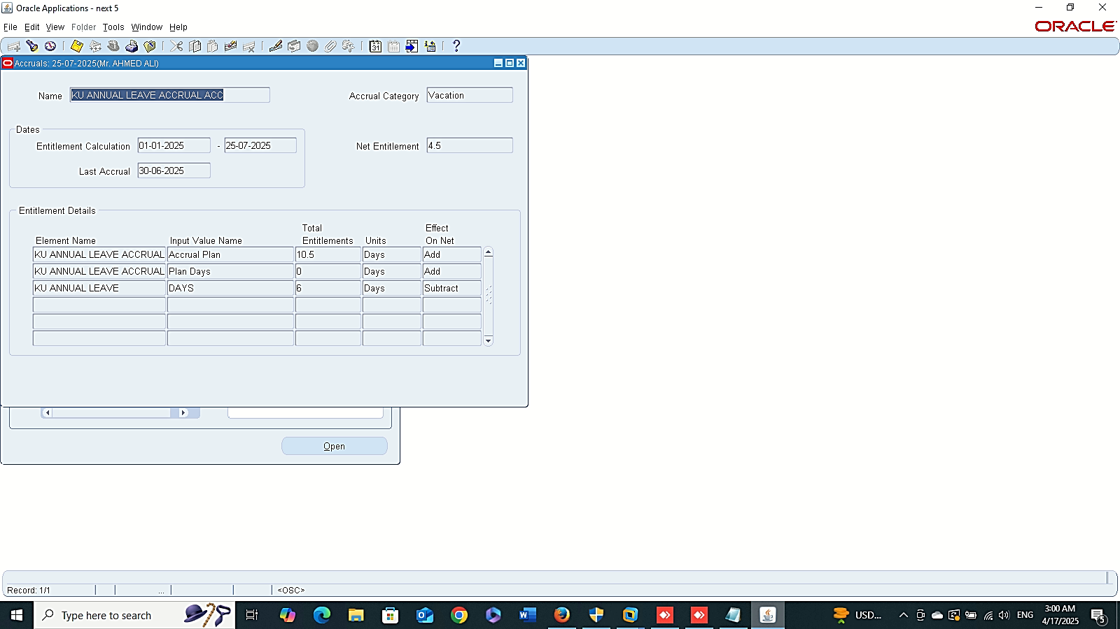
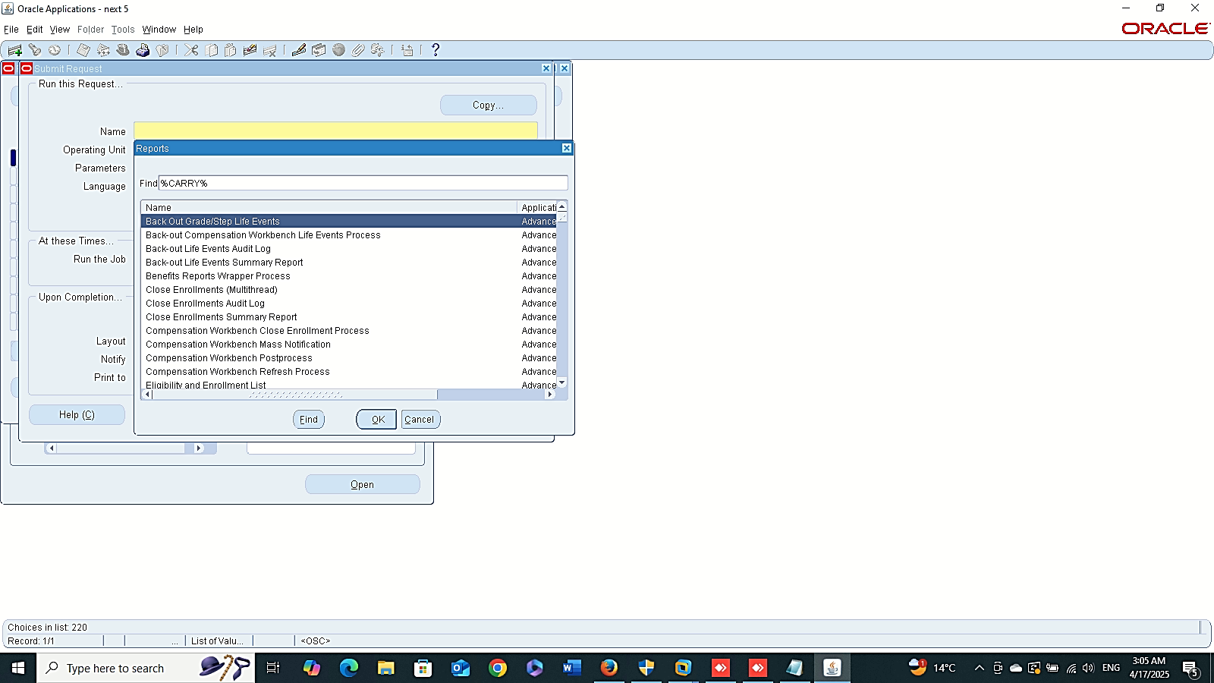
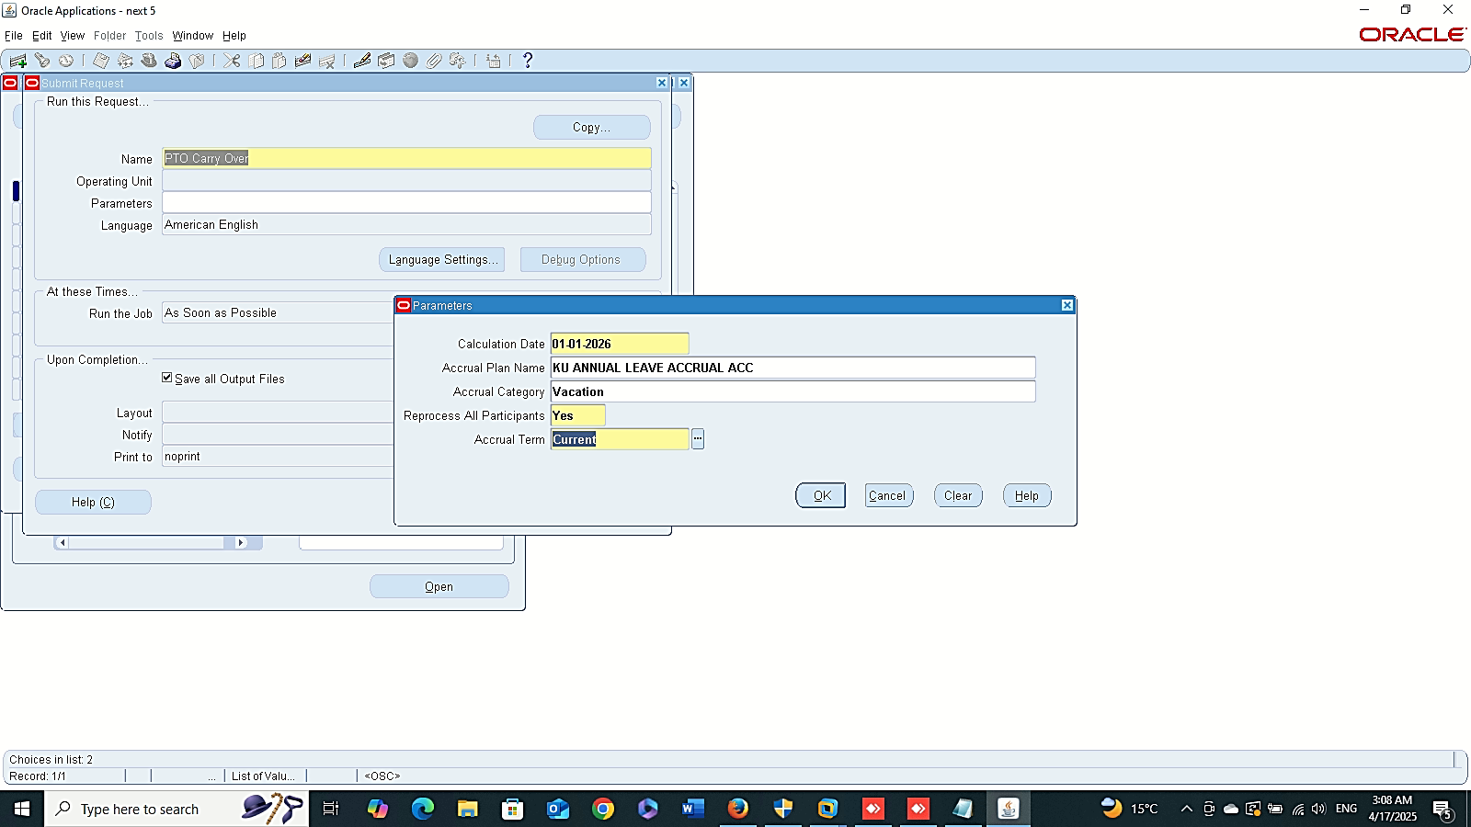
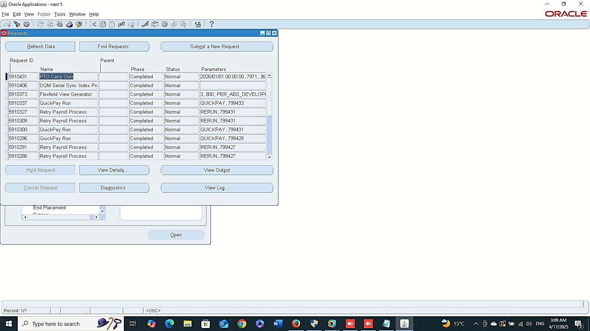
Fast Path Accrual
Finance Management (Payroll)
Absence Management :
“Accrual Plans Setup”
- Fast Path Accrual
GLOBAL HRMS MANAGER > FASTPATH > ACCRUALS > FIND
- Carry Over
GLOBAL HRMS MANAGER > VIEW > REQUEST > AUBMIT A NEW REQUEST
Carry Over

Slide 10
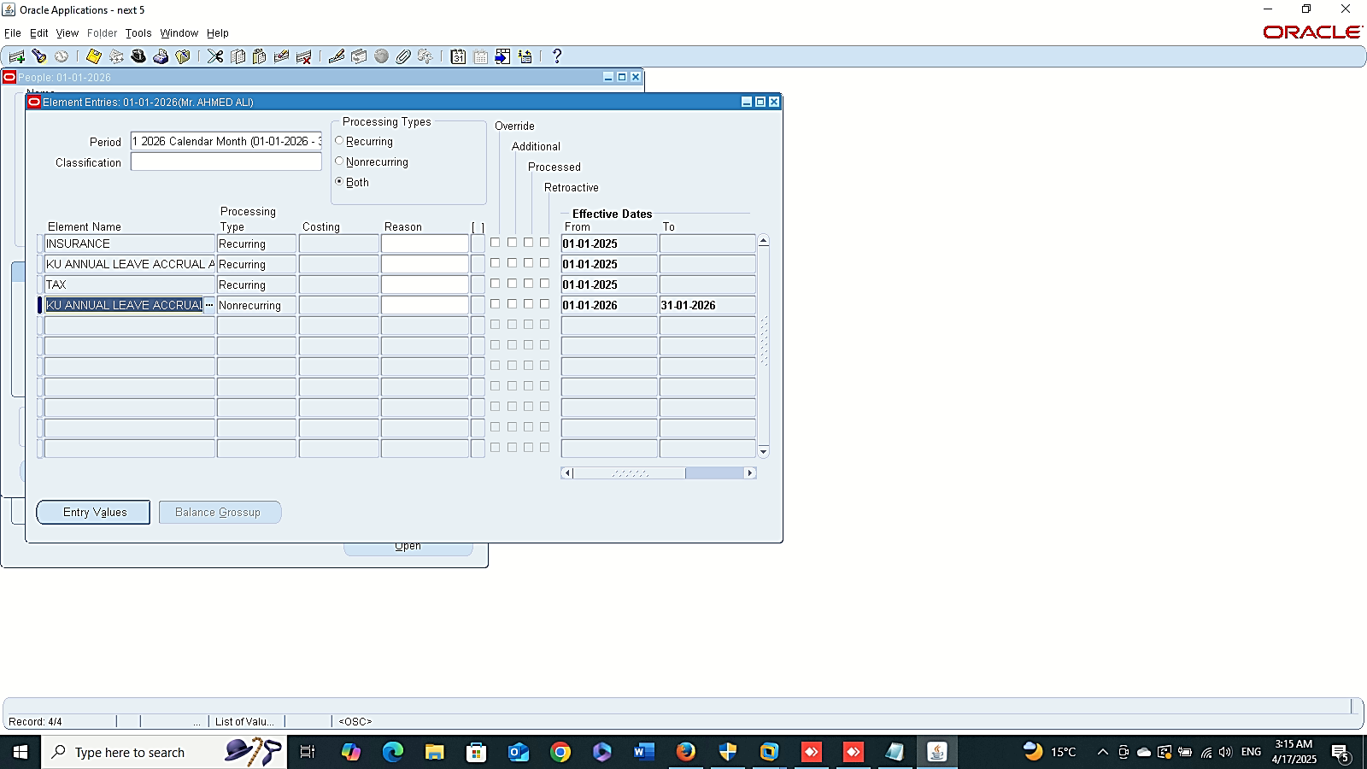

KU Annual Leave Accrual ACC Carried Over
Finance Management (Payroll)
Absence Management :
“Accrual Plans Setup”
- People
GLOBAL HRMS MANAGER > PEOPLE > ENTER AND MAINTAIN > FIND > ASSIGNMENT > ENTRIES

